Slide 1
Development of 2 Bit ALU
For process simulation
Mentored by:
Dr. Satyendra Sharma
Co-Ordinator:
Dr. Shivesh Tripathi
Submitted by: Rishabh Khugshal
Sahil Verma
Rishabh Singh
Rohan Kamat

Slide 2
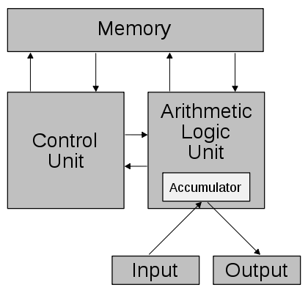
Arithmetic Logic Unit
Arithmetic Logic Unit (ALU) is a vital component of any computing system. It is a digital Combinational circuit that performs the required arithmetic as well as logical operations on the operands. Earlier Von Neumann proposed first ALU in 1945 when he was working on EDVAC. Conventionally ALU’s were designed using basic logic gates such as AND, OR, NOT etc. However these gates dissipate some amount of energy due to the information loss during the operation.

Slide 3
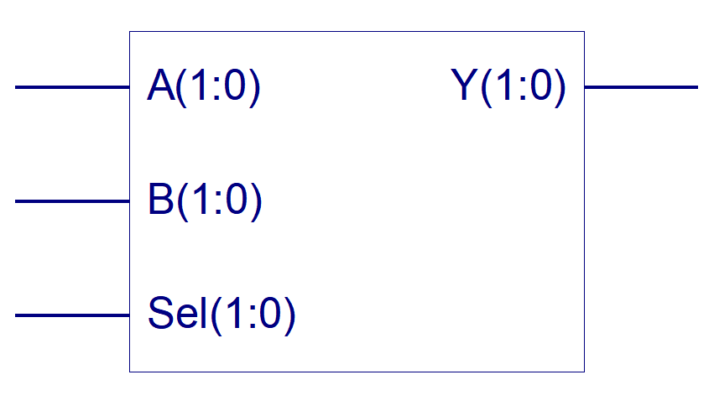
Block Diagram of the 2 Bit ALU
Output
Input Data
Select
Line
Synthesized in Xilinx ISE 8.1i

Slide 4
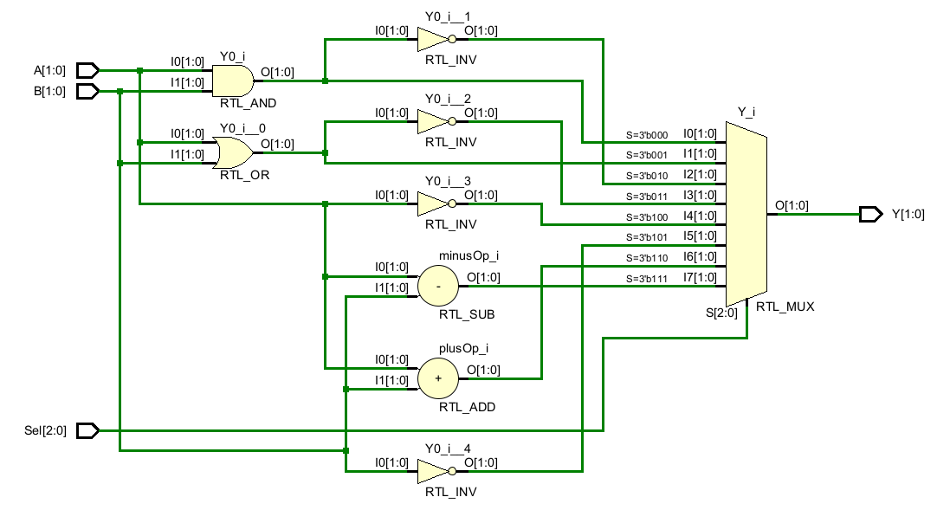
Circuit Diagram

Slide 5
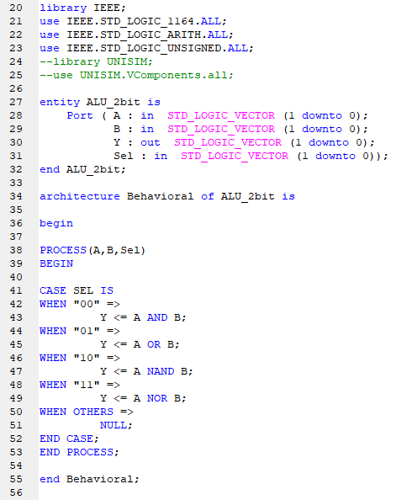
Progress so far…
We have synthesized the Logical Unit for the ALU, now there is The Arithmetic Unit to be constructed and synthesized. Here is the HDL code for Logical Unit

Slide 6
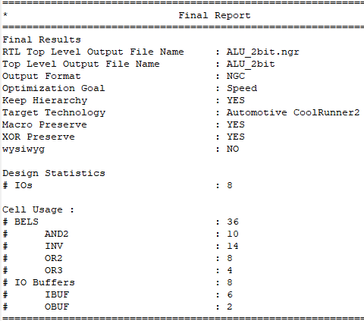
Components required
Quad 2-i/p AND Gates (7408)
Quad 2-i/p OR Gates (7432)
HEX Inverter / NOT Gates (7404)
Dual 4 to 1 line MUX (74153)
-There might more ICs be adding as for Arithmetic Operations

Slide 7
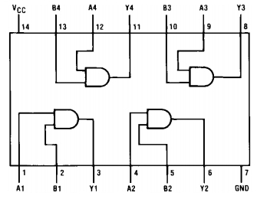
IC 7408 – AND Gate IC

Slide 8
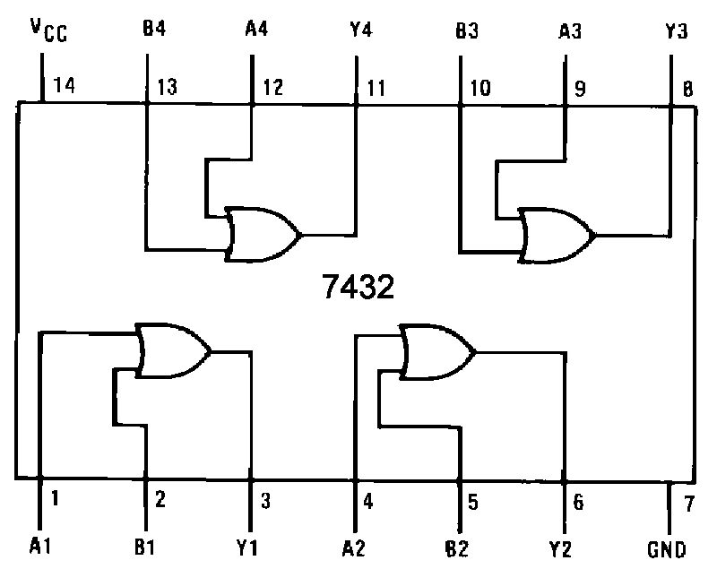
IC 7432 – OR Gate IC

Slide 9
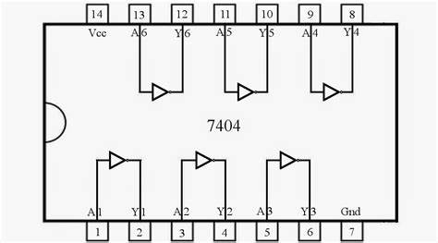
IC 7404 – NOT Gate IC

Slide 10
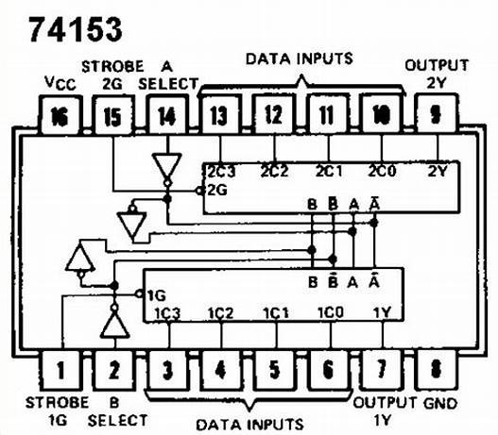
IC 74LS153 – MUX IC

Slide 11
Working of the project
This ALU can perform AND, OR, NAND and NOR and arithmetic operations. Implementing Full Adder module to do Arithmetic Operations also. Circuit diagram can be seen on the next slide for Arithmetic Logic Unit.

Slide 12
Truth Table of AND Gate
A | B | Y = A & B
0 | 0 | 0
0 | 1 | 0
1 | 0 | 0
1 | 1 | 1

Slide 13
Truth Table of OR Gate
A | B | Y = A & B
0 | 0 | 0
0 | 1 | 1
1 | 0 | 1
1 | 1 | 1

Slide 14
Truth Table of NOT Gate
A | Y = ~A
0 | 1
1 | 0

Slide 15
Truth Table of ALU
A | B | S1 | S0 | Y
00 | 00 | 0 | 0 | 00
00 | 01 | 0 | 1 | 01
00 | 10 | 1 | 0 | 11
00 | 11 | 1 | 1 | 00
01 | 00 | 0 | 0 | 00
01 | 01 | 0 | 1 | 01
01 | 10 | 1 | 0 | 11
01 | 11 | 1 | 1 | 00
10 | 00 | 0 | 0 | 00
10 | 01 | 0 | 1 | 11
10 | 10 | 1 | 0 | 01
10 | 11 | 1 | 1 | 00
11 | 00 | 0 | 0 | 00
11 | 01 | 0 | 1 | 11
11 | 10 | 1 | 0 | 01
11 | 11 | 1 | 1 | 00
AND
OR
NAND
NOR
AND
OR
NAND
NOR
AND
OR
NAND
NOR
AND
OR
NAND
NOR

Slide 16
References
www.bravelearn.com
www.electronics-tutorials.ws
www.knowelectronic.com
www.circuitspedia.com

